Slide 1
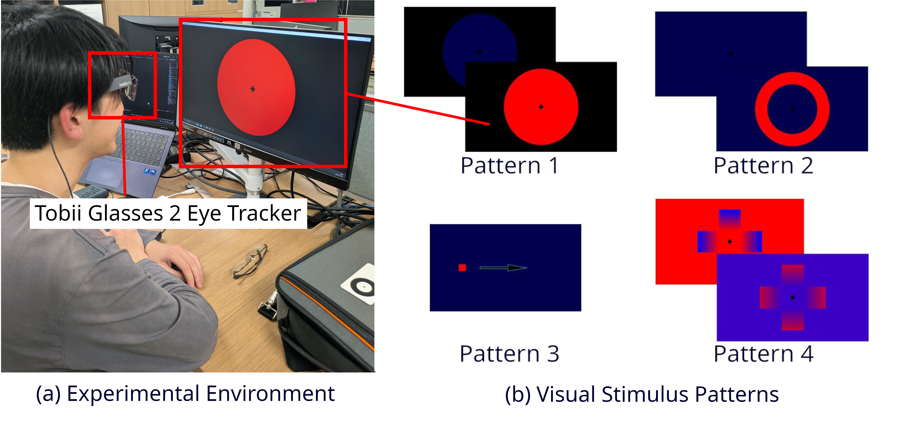
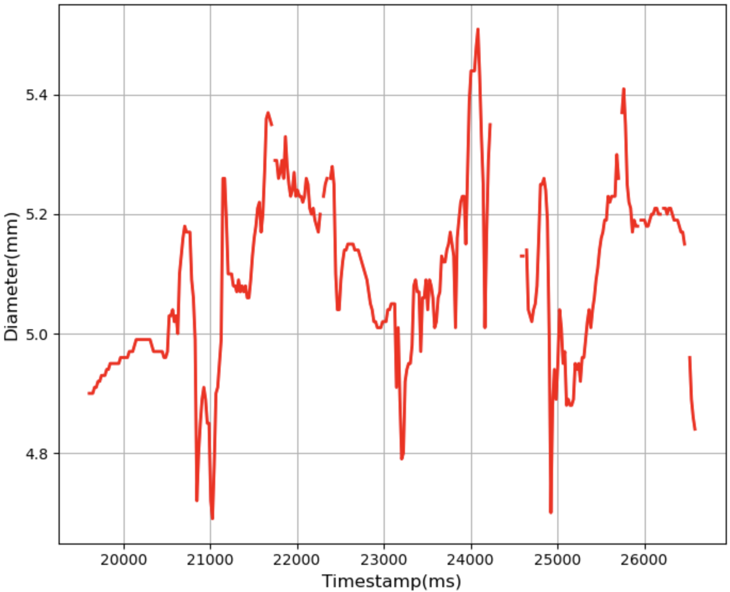
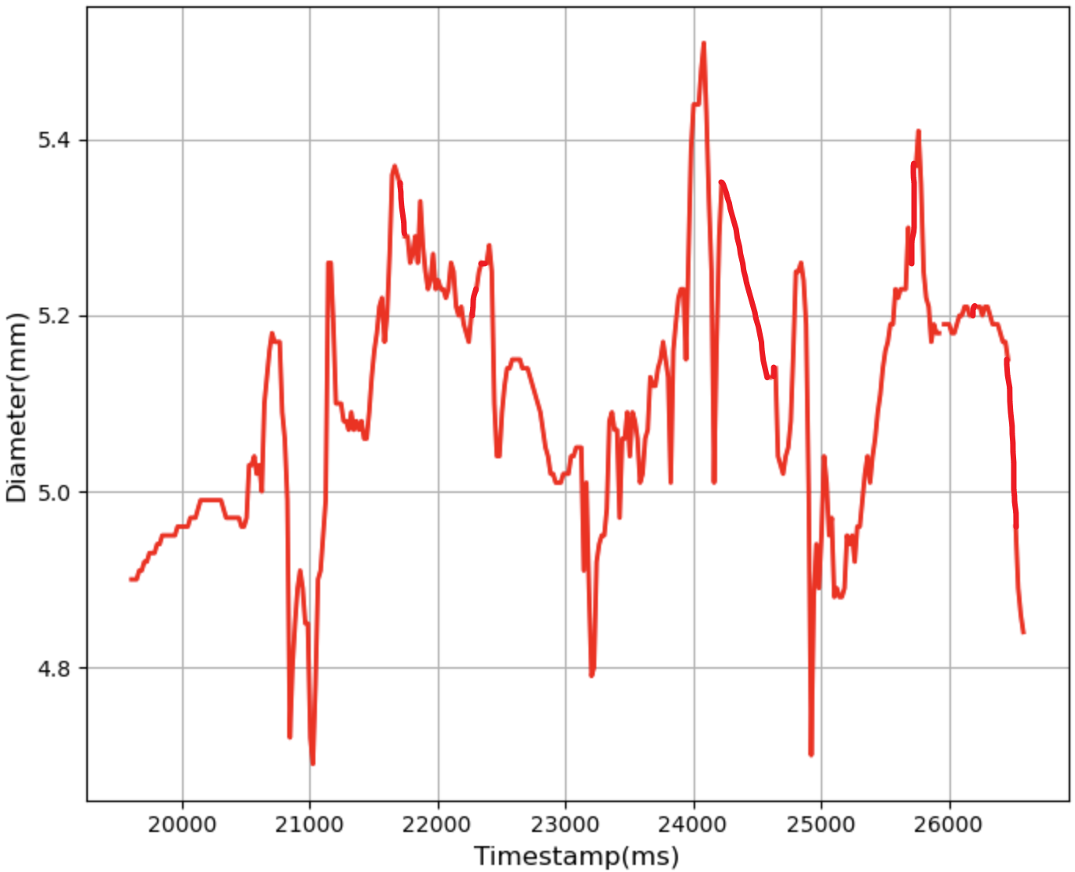
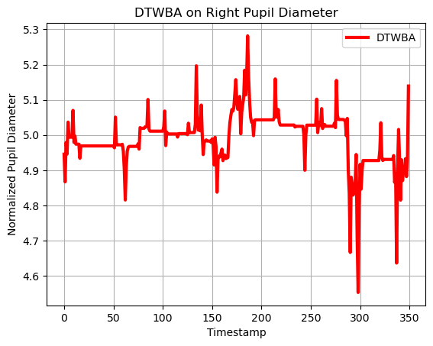
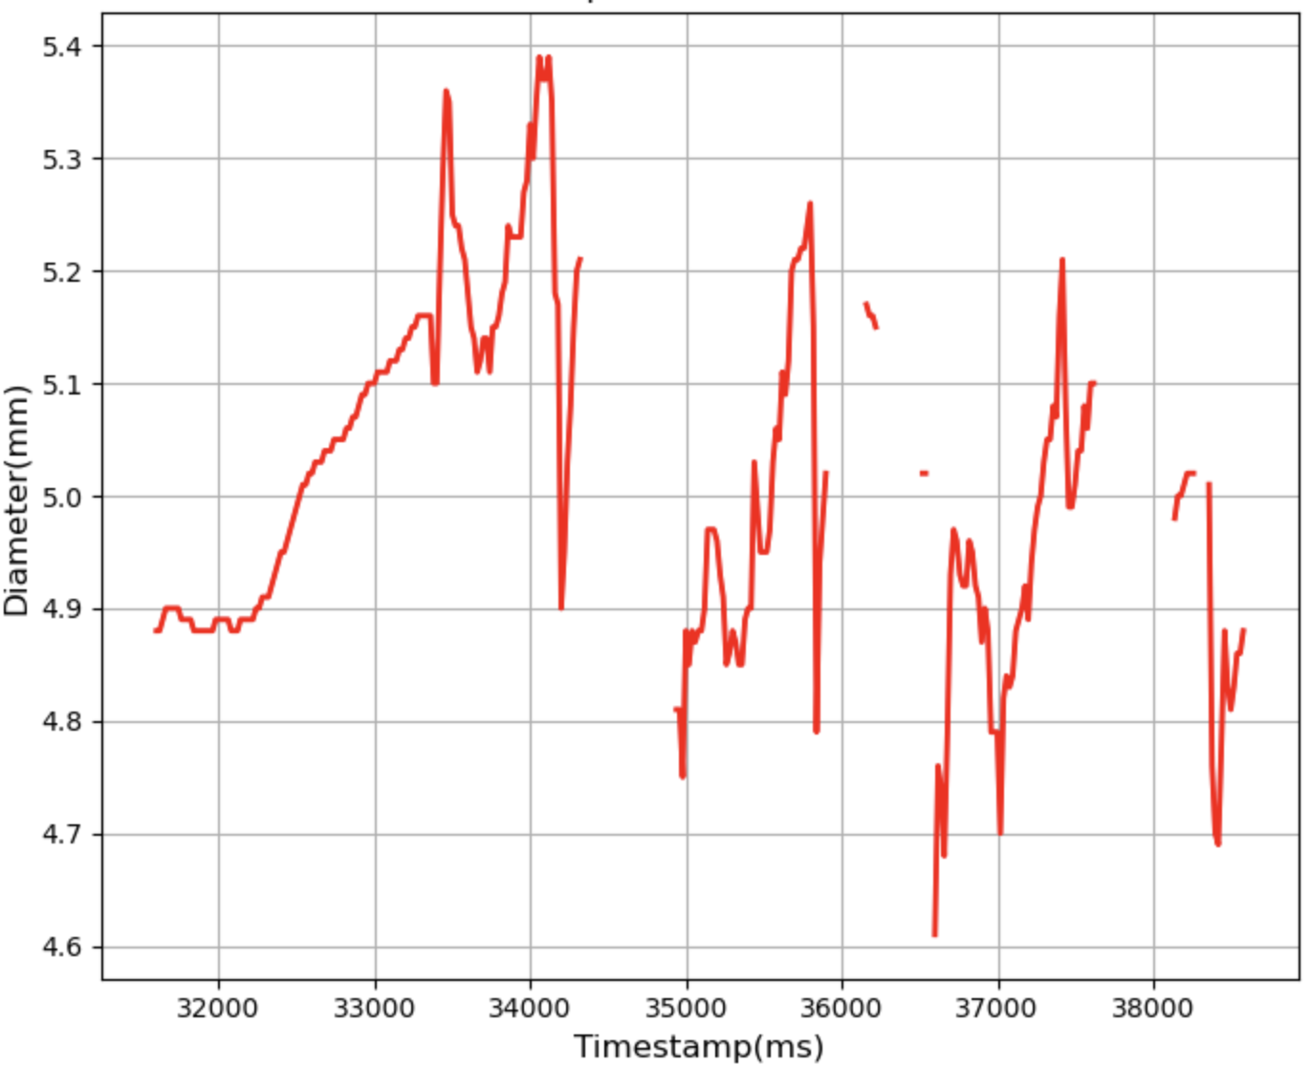
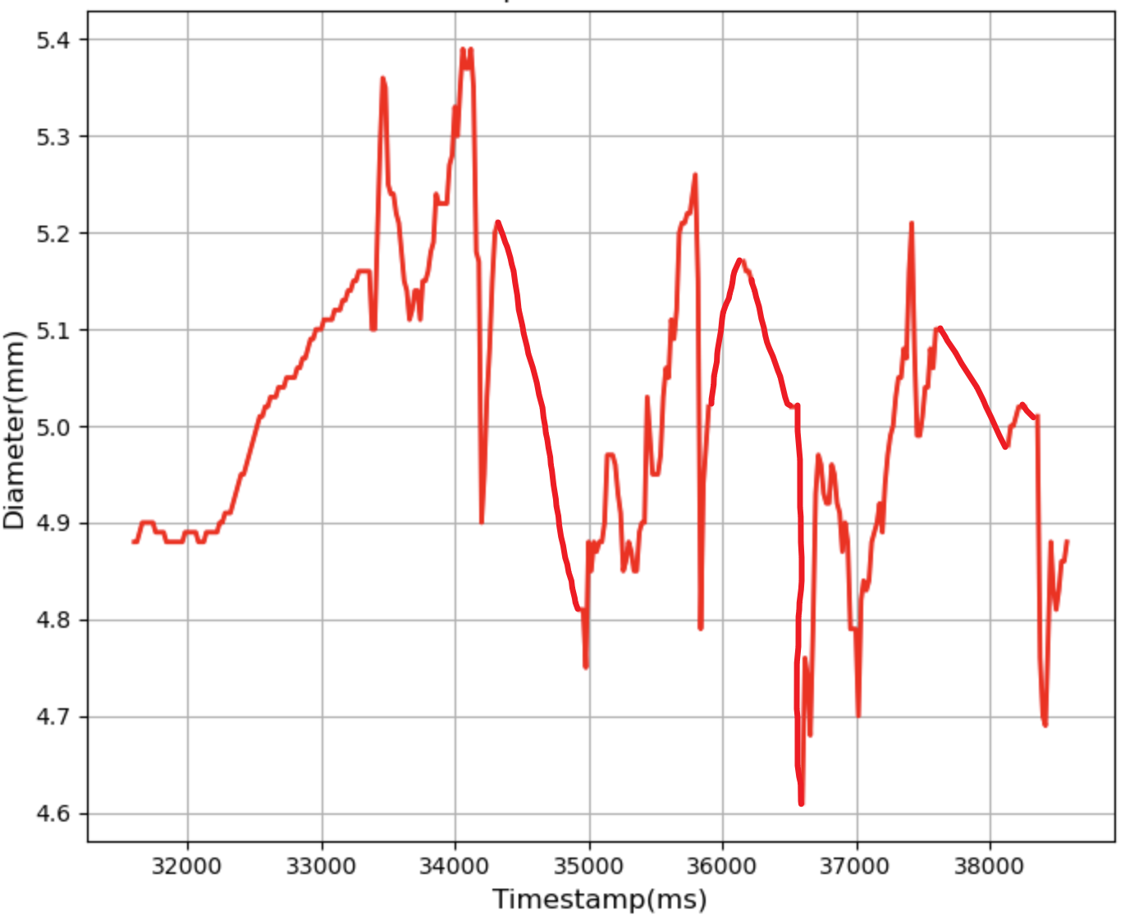
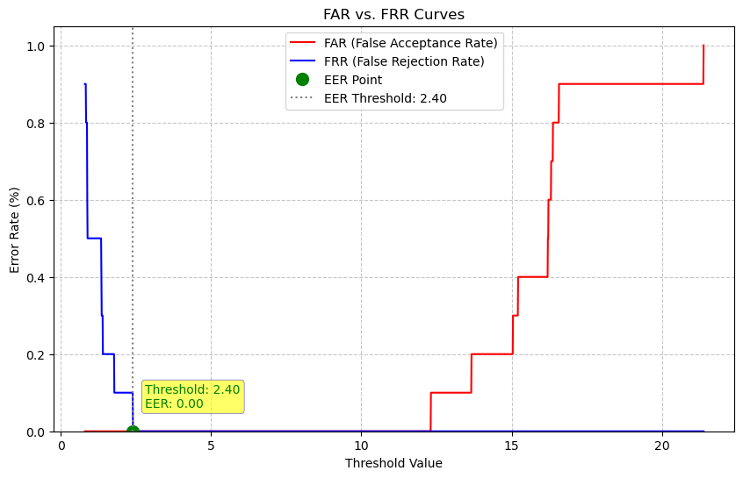
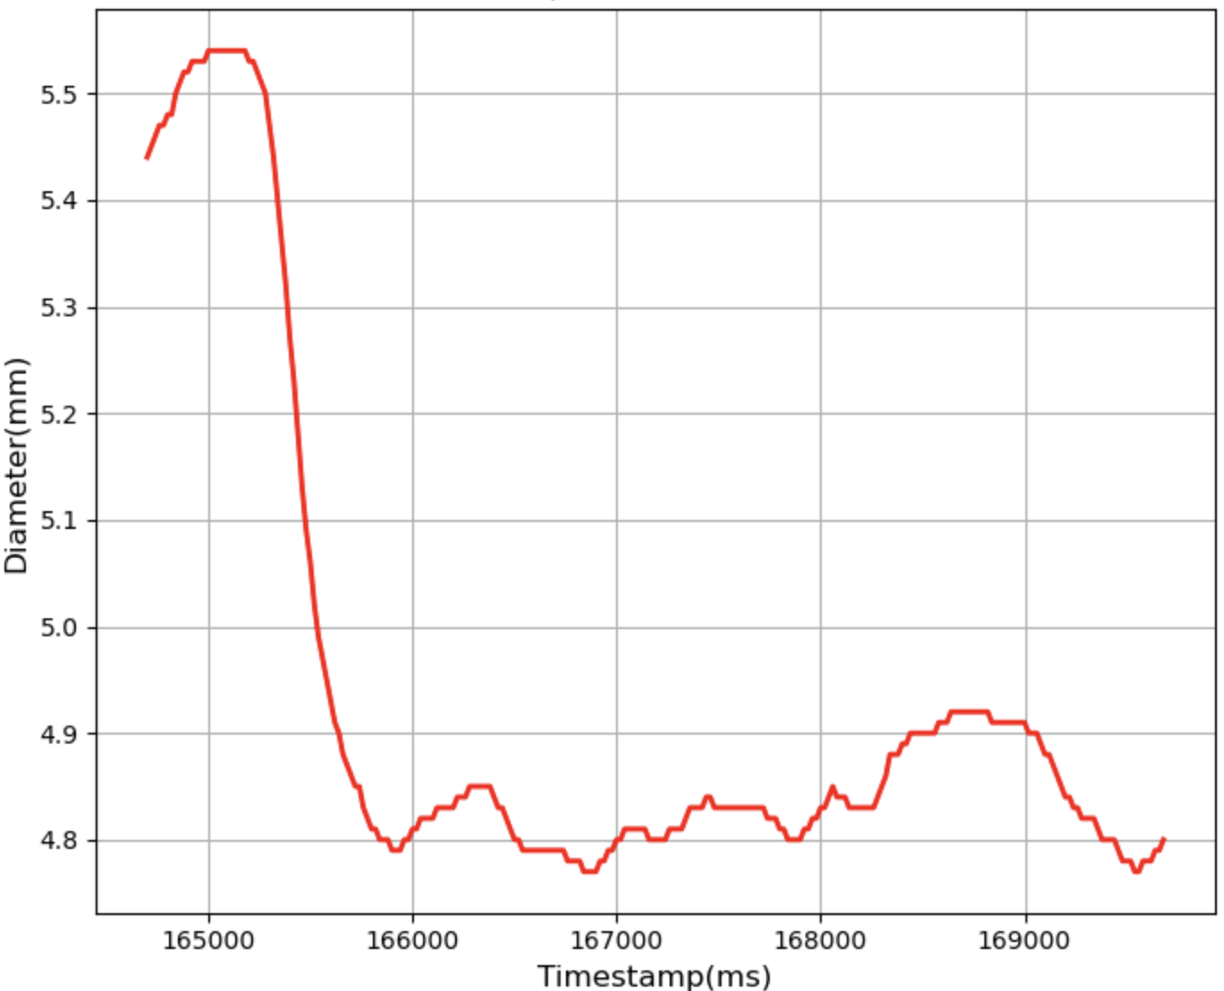
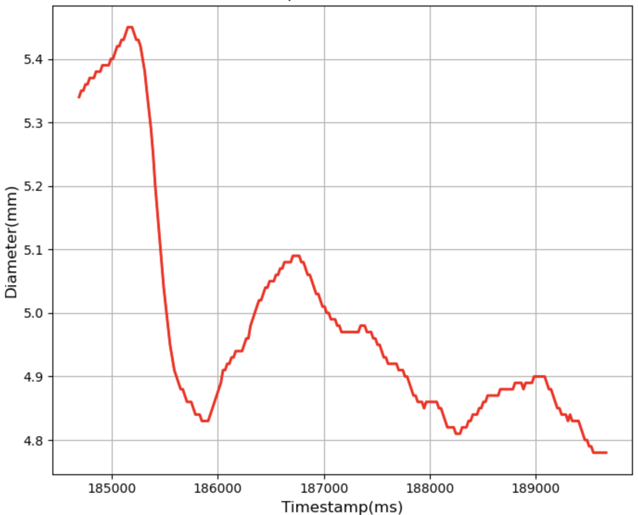
Data Collection
Linear Interpolation & DBA Generation
Origin Interpolated DBA
… …
Identification Determination (Evaluated by EER)
DTW Requisition
EERs from
Original Participant
EERs from
Another Participant
Comparison with Original Participant
Comparison with Another Participant
1.11
1.13
1.21
1.20
… …
2.01
1.64
1.32
1.98
… …
1.11
1.13
1.21
1.20
… …
2.01
1.64
1.32
1.98
… …
… …
… …

